Slide 1


Slide 2
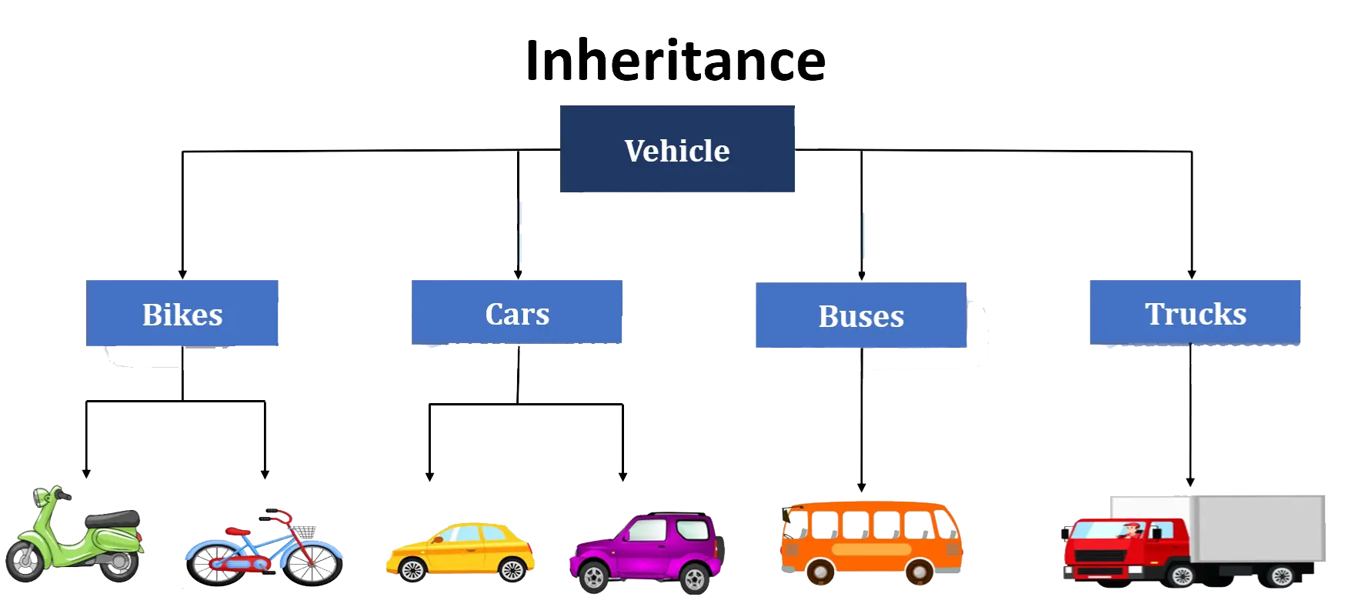

Slide 3
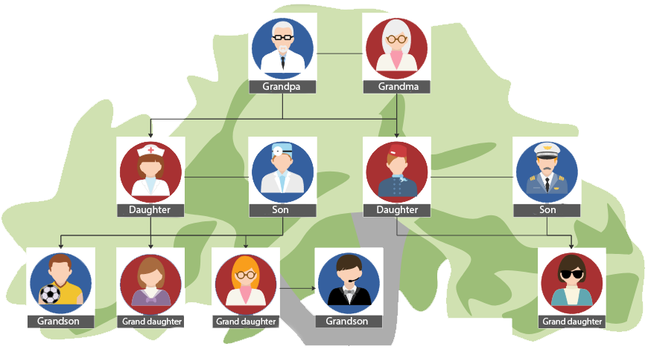
Introduction to Inheritance
Definition
Inheritance is a mechanism in object-oriented programming that allows one class (child class) to inherit the properties and methods of another class (parent class)
Purpose
Promotes code reusability and establishes a relationship
between classes

Slide 4

Basic Terminology
Parent Class
Base Class
The class whose properties and methods are inherited
Child Classs
Derived Class
The class that inherits from the parent class
Inheritance
The act of inheriting properties and methods
from another class

Slide 5
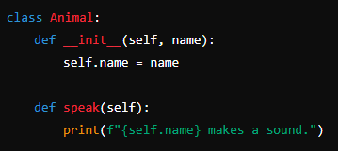

Creating a Parent Class
This Animal class has an __init__ method to initialize the name attribute and a speak method to print a message

Slide 6
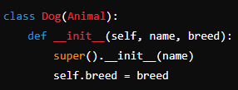
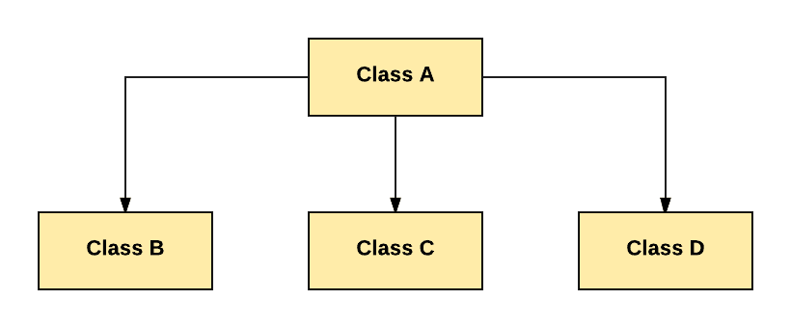
Creating a Child Class
The Dog class inherits from the Animal class.
It uses super() to call the parent class's __init__ method and adds a new attribute breed

Slide 7
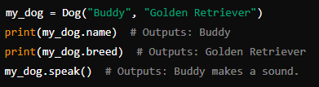
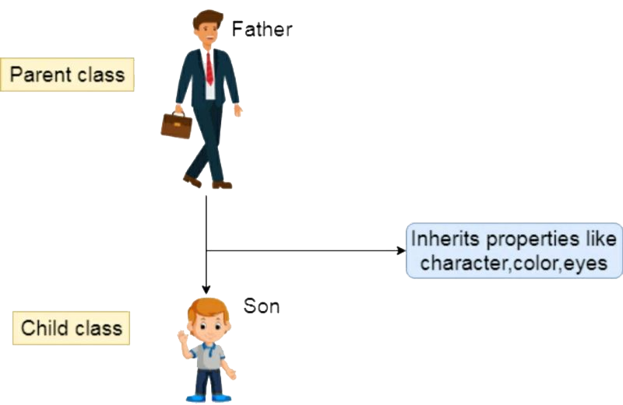
Using Child Class
This code creates an instance of the Dog class and demonstrates accessing inherited attributes and methods

Slide 8
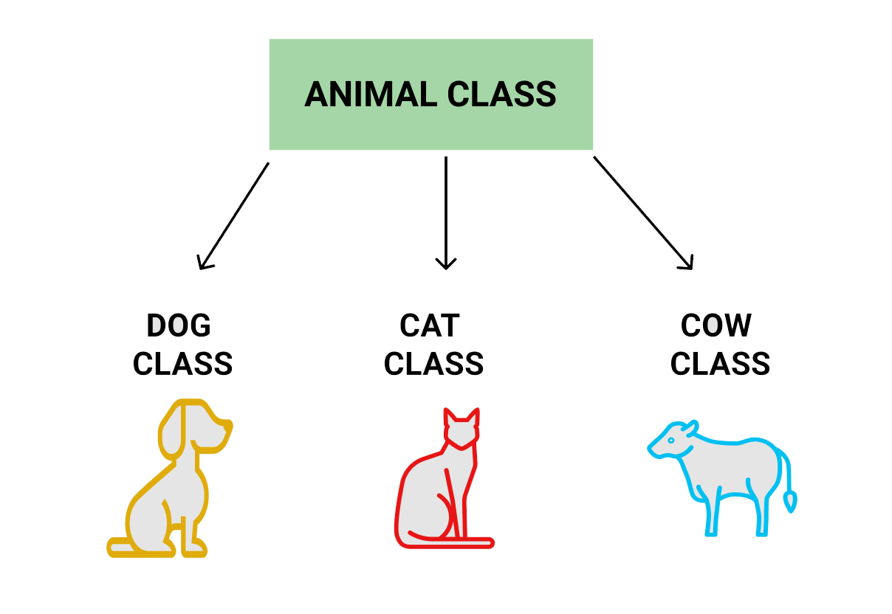
Inheritance Hierarchy

Slide 9

Benefits of Inheritance
Code Reusability
Write common code in the parent class and reuse it in child classes
Logical Hierarchy
Represents real-world relationships between objects
Maintainability
Code becomes easier to understand, modify, and extend when using inheritance properly

Slide 10

What is the difference between constructor and method?
Why constructor is required in instantiation?

Slide 11

HOME
Think of an app of your choice
Create at least 2 classes which belong to that app

